Slide 1

Supply Chain Analytics Using Python

Slide 2



Supply Chain
The network of firms and facilities involved in the transformation process from raw materials to a product and in the distribution of that product to customers.
In a supply chain
Physical flow
Financial flow
Information (order)
o Information flow
Information (Status)
Physical (delivery)
Financial (payment)

Slide 3
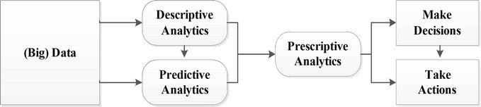
(Big) Data Analytics
What has happened,
What is happening, and
Why
What should be happening? and
How to influence it
What will be happening or likely to happen
Some of the crucial scenarios in Supply Chain that prescriptive analytics allows organization/companies to answer include:
What kind of an offer should we make to each customer?
What should be the plant / warehouse location?
What should be the shipment strategy for each retail location?
Which product should I launch and when?

Slide 4
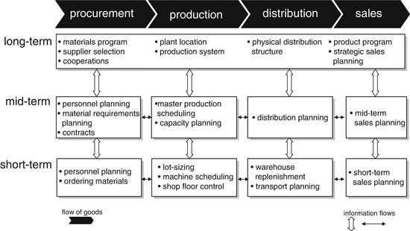
Supply Chain Planning Matrix

Slide 5
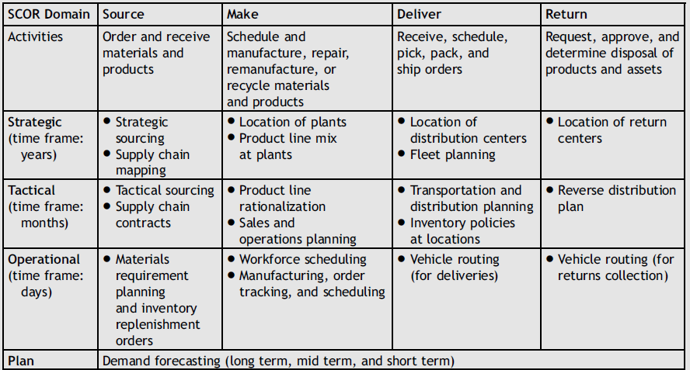
Supply Chain Planning & Supply Chain Operations Reference (SCOR) model
Souza, G. C. (2014). Supply chain analytics. Business Horizons, 57(5), 595-605.

Slide 6
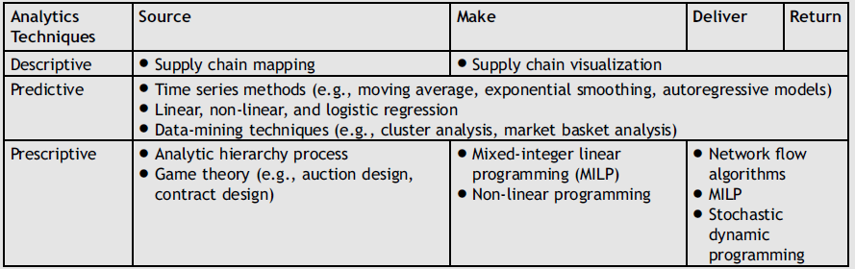
Analytic Techniques used in Supply Chain Management
Souza, G. C. (2014). Supply chain analytics. Business Horizons, 57(5), 595-605.

Slide 7
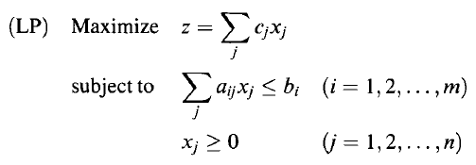
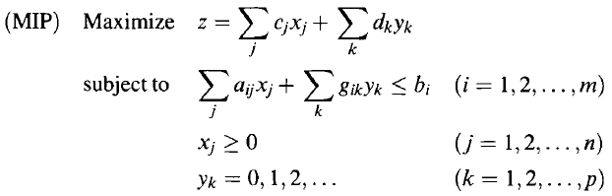
Mixed Integer Linear Programming

Slide 8
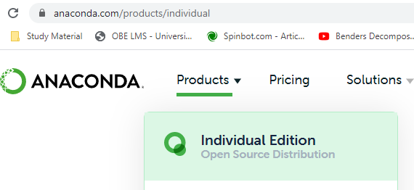
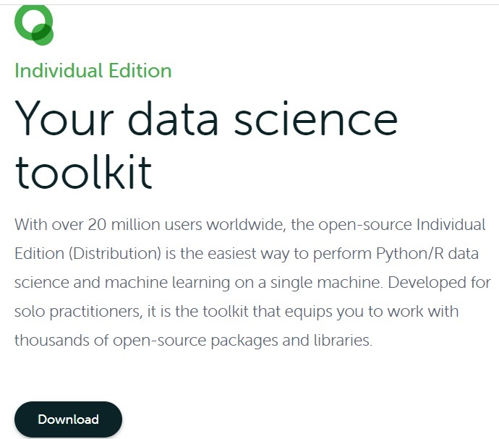
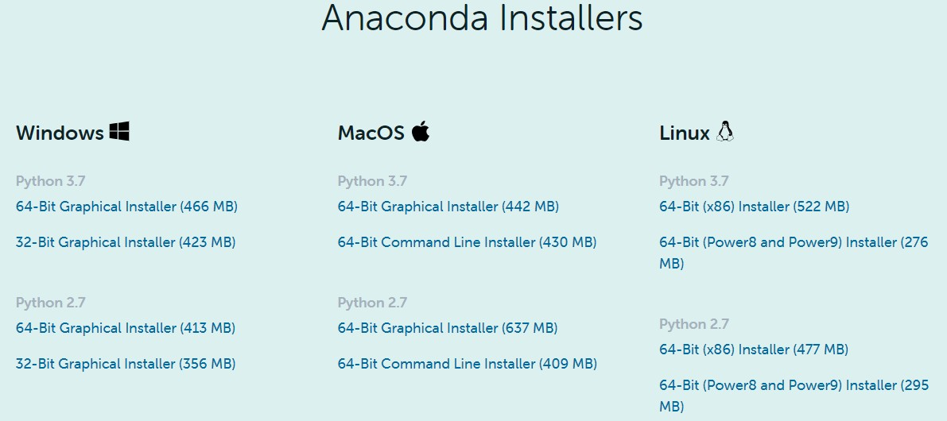
Installation: Anaconda distribution
What is Anaconda distribution?
Anaconda is a freemium open source distribution of the Python and R programming languages
It includes hundreds of popular data science packages
Official Website for Installing Anaconda
https://www.anaconda.com/products/individual

Slide 9


Install and Manage Package / Library in Python
pip package manager | Conda package manager
pip list | conda list
pip search packagename | conda search packagename
pip install packagename | conda install packagename
pip install packagename --upgrade | conda update packagename

Slide 10
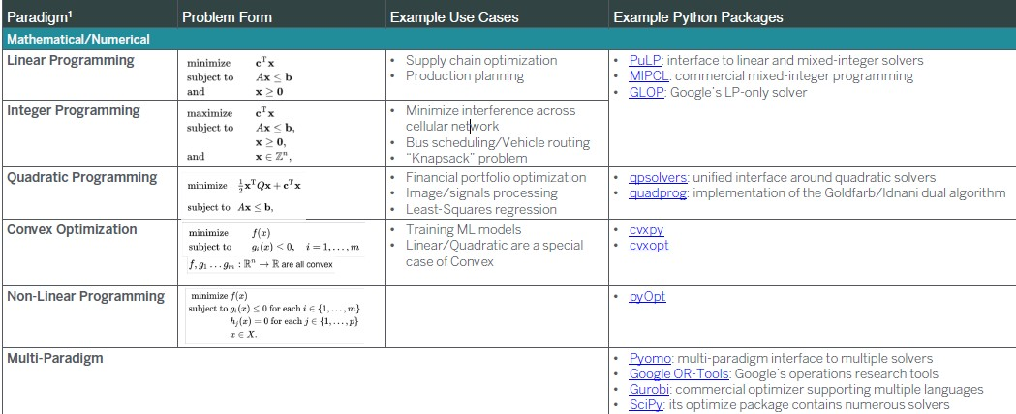
Python Libraries for Optimization (Operations Research)

Slide 11
What is PuLP?
https://coin-or.github.io/pulp/
PuLP is a modeling framework for Linear (LP) and Integer Programing (IP) problems written in Python
Maintained by COIN-OR Foundation (Computational Infrastructure for Operations Research)
PuLP interfaces with different Solvers
o CPLEX, COIN, Gurobi, etc…

Slide 12
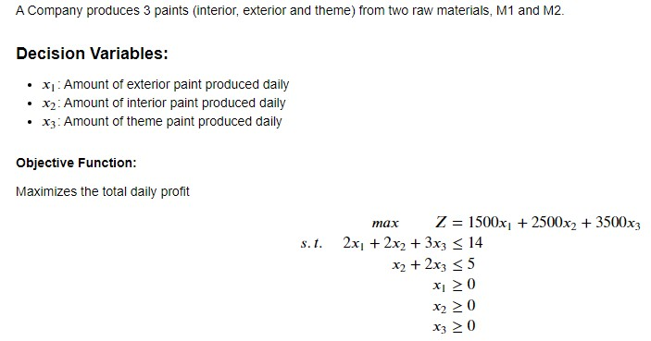
Product Mix Problem : LP Model

Slide 13
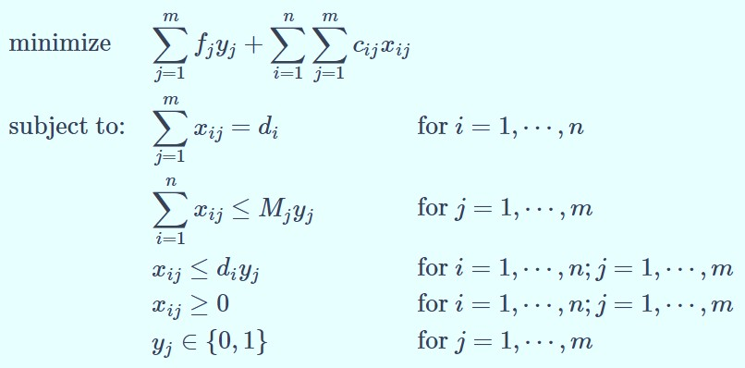
The Capacitated Plant (Facility) Location Problem : MIP Model
Consider a company with three potential sites for installing its facilities/warehouses and five demand points. Each site 𝑗 has a yearly activation cost (fixed cost) 𝑓_{𝑗} , i.e., an annual leasing expense that is incurred for using it, independently of the volume it services. This volume is limited to a given maximum amount that may be handled yearly, 𝑀_{𝑗} . Additionally, there is a transportation cost 𝑐_{𝑖𝑗} per unit serviced from facility 𝑗 to the demand point 𝑖. These data are shown in Table Data for the facility location problem: demand, transportation costs, fixed costs, and capacities.
Data for the facility location problem: demand, transportation costs, fixed costs, and capacities
Customer 𝑖 | 1 | 2 | 3 | 4 | 5
Annual demand 𝑑_{𝑗} | 80 | 270 | 250 | 160 | 180
Facility 𝑗 | ^{𝑐}𝑖𝑗 |  |  |  |  | 𝑓_{𝑗} | 𝑀_{𝑗}
1 | 4 | 5 | 6 | 8 | 10 | 1000 | 500
2 | 6 | 4 | 3 | 5 | 8 | 1000 | 500
3 | 9 | 7 | 4 | 3 | 4 | 1000 | 500
Indices:
o 𝑛 customers 𝑖 = 1,2, … , 𝑛
o 𝑚 sites for facilities 𝑗 = 1,2, … , 𝑚
Decision Variables:
𝑥_{𝑖𝑗} ≥ 0 → amount serviced from facility 𝑗 to demand point 𝑖
𝑦_{𝑗} = 1 if a facility is established at location 𝑗, 𝑦_{𝑗} = 0 otherwise.

Slide 14
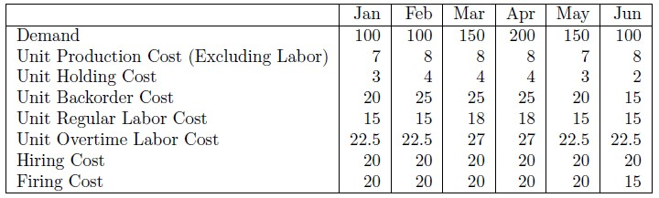
Aggregate Production Planning: MIP Model
Assumption :
Hiring and firing are allowed in addition to using overtime from the regular work force.
Backorders are allowed.
Minimize = σ^{𝑁}
_{σ}𝑇
^{𝑐}𝑖𝑡 ^{𝑋}𝑖𝑡 ^{+ ℎ}𝑖𝑡 ^{𝐼}𝑖𝑡 ^{+ 𝑏}𝑖𝑡 ^{𝐵}𝑖𝑡
+ σ^{𝑇} ₁ 𝑟_{𝑡} 𝑅_{𝑡} + 𝑜_{𝑡} 𝑂_{𝑡} + ℎ_{𝑡} 𝐻_{𝑡} + 𝑓_{𝑡} 𝐹_{𝑡}
𝑡=
𝑖=1 𝑡=1
Subject to:
^{𝑋}𝑖𝑡 ^{+ 𝐼}𝑖⁺,𝑡−1 ^{− 𝐼}𝑖𝑡^{+ 𝐵}𝑖,𝑡−1 ^{+ 𝐵}𝑖𝑡 ^{= 𝑑}𝑖𝑡
Ɐ i, t Ɐ 𝑖, 𝑡 Ɐ 𝑖, 𝑡 Ɐ 𝑖, 𝑡 Ɐ𝑡
Ɐ 𝑖, 𝑡
(Integer)
(Inventory-Balancing Constraints) (Time Required to produce products) (Regular Time Required)
(Regular Time Required) (Non-negative constraint) (Non-negative constraint)
_{σ}𝑁
𝑚_{𝑖}𝑋_{𝑖𝑡} − 𝑅_{𝑡} − 𝑂_{𝑡} ≤ 0
𝑅_{𝑡} − 𝑅_{𝑡−1} − 𝐻_{𝑡} + 𝐹_{𝑡} = 0
𝑂_{𝑡} − 𝑝𝑅_{𝑡} ≤ 0
𝑅_{𝑡},𝑂_{𝑡}, 𝐻_{𝑡}, 𝐹_{𝑡} ≥ 0
𝑋_{𝑖𝑡} , 𝐼_{𝑖𝑡} , 𝐵_{𝑖𝑡} ≥ 0
^{𝑋}𝑖𝑡
𝑖=1
Example: We will assume a unit production rate, that overtime is at most 25% of regular labor, Initial Inventory is 3 units, Initial available regular hour and Backorders are 0 (Zero), and the data from the following table.

Slide 15
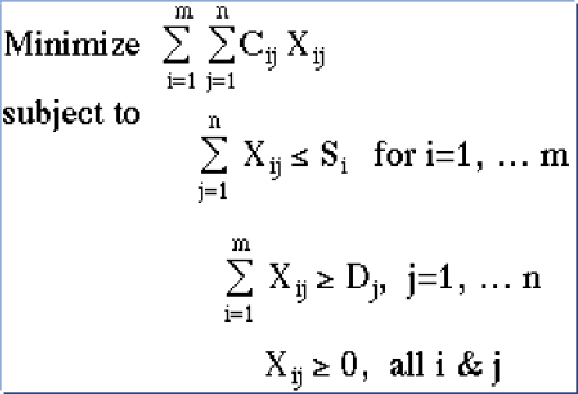
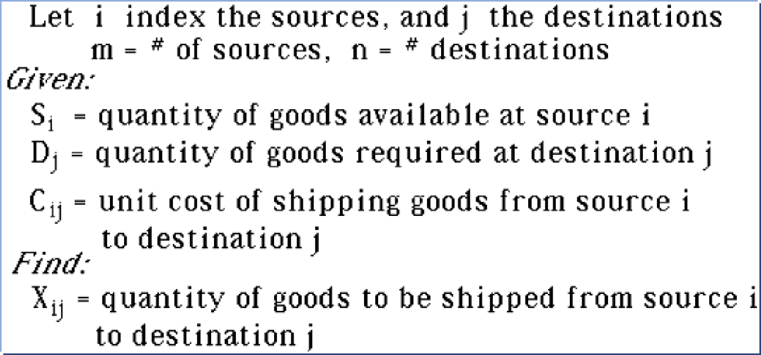
Transportation Problem: LP Model
Punjab Flour Mill has four branches A, B, C & D and four warehouses 1, 2, 3, and 4. Production, demand and transportation costs are given below:
Transportation Costs (in Rs):
PRODUCTION (TONES) | DEMAND (TONES)
A – 35 | 1 – 70
B – 50 | 2 – 30
C – 80 | 3 – 75
D – 65 | 4 – 55
 | 1 | 2 | 3 | 4
A | 10 | 7 | 6 | 4
B | 8 | 8 | 5 | 7
C | 4 | 3 | 6 | 9
D | 7 | 5 | 4 | 3
Find the optimal solution.

Slide 16
Thank you

